Slide 1
DRUGS USED IN MOVEMENT DISOEDERS

Slide 2
Parkinson disease
Other
Benign essential tremor
Chorea
Hemiballism
Tics
Dystonia
DRUGS USED IN MOVEMENT DISOEDERS

Slide 3
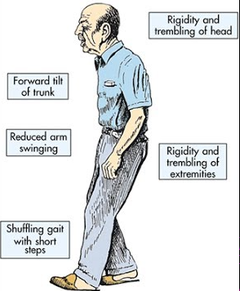
Parkinson Disease
Tremor
Rigidity
Akinesia
Postural instability

Slide 4

Aims of treatment
Control Symptoms Minimize disability Improve quality of life
Very effective initially
Long term effectiveness is limited

Slide 5
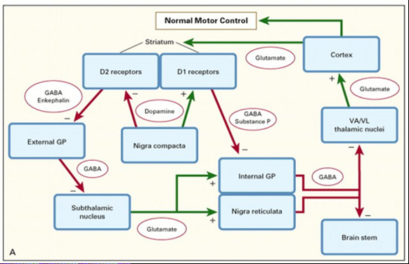
Pathophysiology

Slide 6
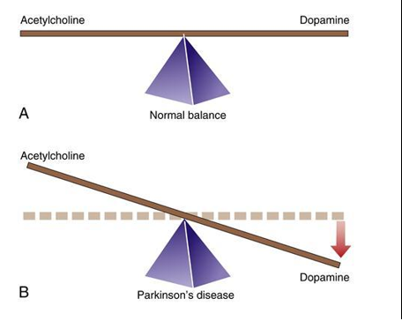
Pathophysiology

Slide 7
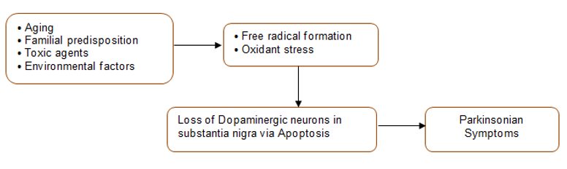
Pathophysiology

Slide 8
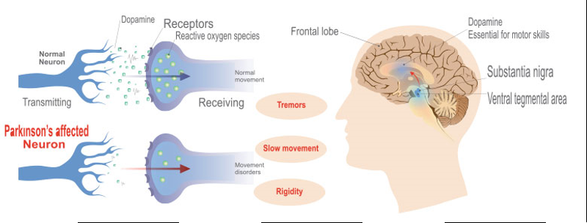
Pathophysiology

Slide 9
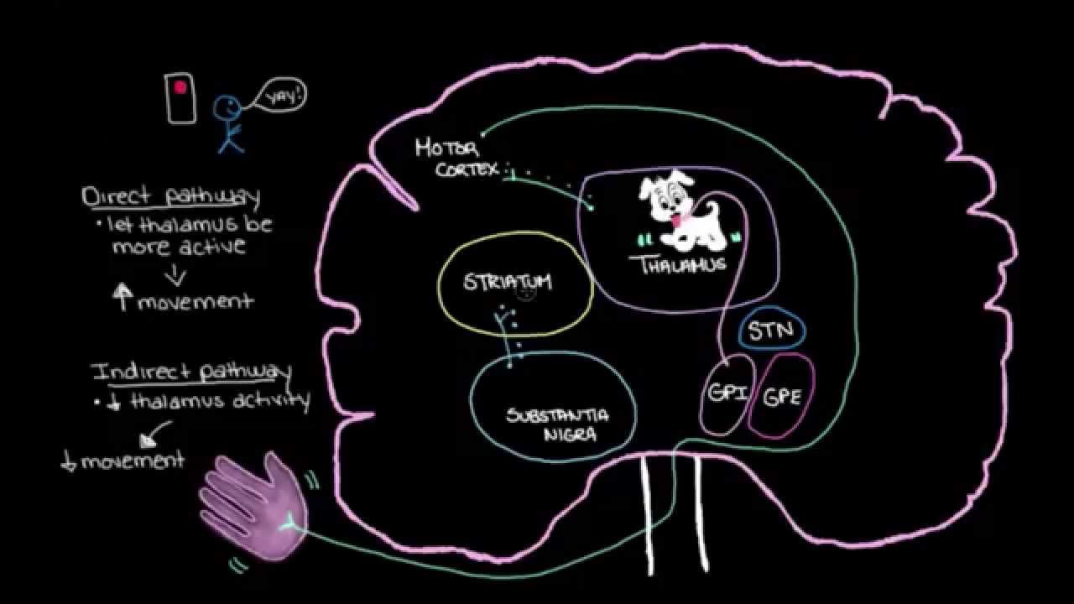

Slide 10
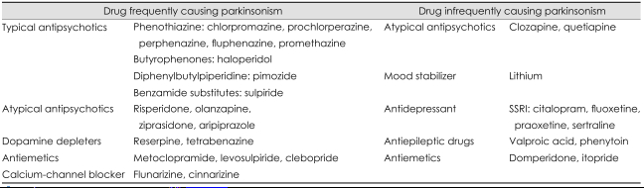
Drug induced parkinsonism Dopamine receptor antagonism

Slide 11
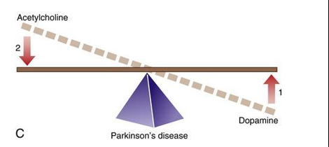
Aims of treatment
Symptomatic control
Cure :
stop or slow down neuronal degeneration

Slide 12
Dopaminergic drugs
Dopamine replacement Levodopa Dopamine receptor agonist Bromocriptine Pergolide Carbegoline | Inhibition of dopamine metabolism MAO inhibitors - Selegiline COMT inhibitors – Entacapone Increased synthesis & release of dopamine Amantadine

Slide 13
Anti cholinergic drugs
Benzhexol
Benzotropine

Slide 14
Neuroprotective agents
Selegiline ?
Ropinirole ?
Pergolide ?
Riluzole ?

Slide 15
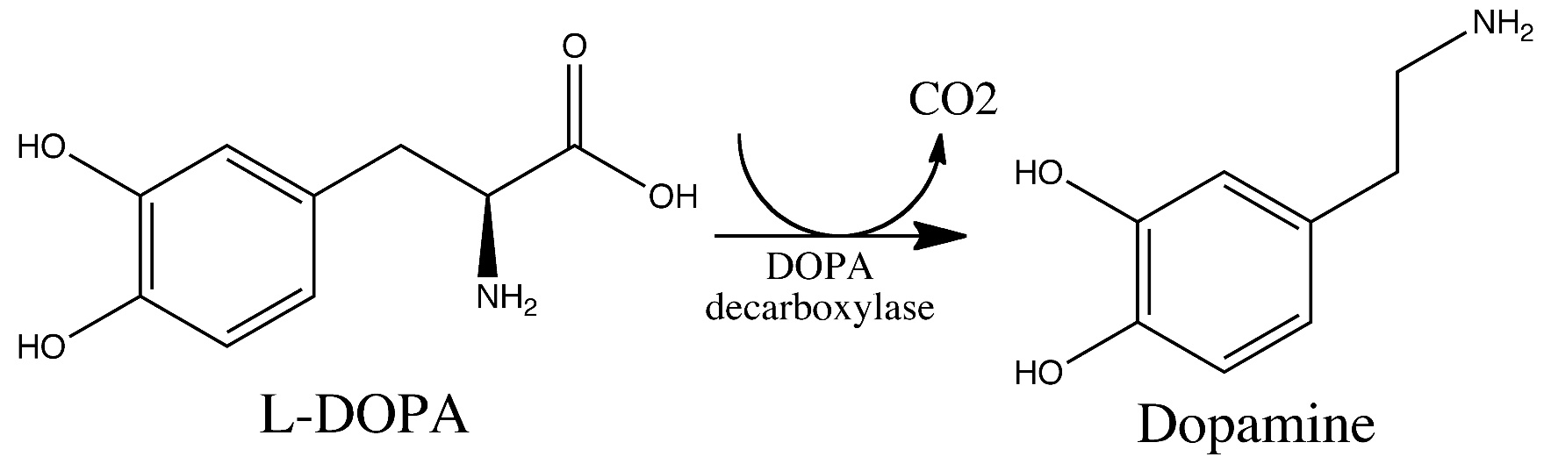
Levodopa
1st line therapy
The most effective drug for symptomatic control
A precursor of dopamine

Slide 16
Why not dopamine ?

Slide 17
Why not dopamine ?
Extensively metabolized in gut, liver and blood by COMT and MAO
Not lipid soluble : Poor CNS penetration

Slide 18
Dopamine
Brain : Therapeutic effect
Periphery : Adverse effect

Slide 19
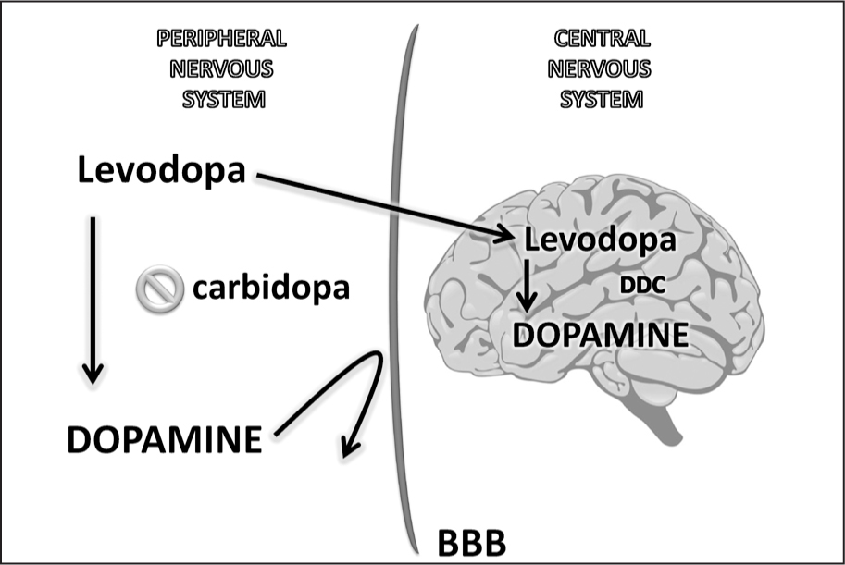

Slide 20
Dopa decarboxylase inhibitors
Carbidopa
Benserazide
Carbidopa + Levodopa = Co-careldopa (Sinemet)
Beserazide + Levodopa = Co-beneldopa (Madopar)
Do not cross BBB
Reduce peripheral adverse effects
Allow to use lower doses of L-dopa

Slide 21
Levodopa - Adverse effects
Central AE | Peripheral AE
Confusion Hallucinations Delusions Agitation | Altered bowel habits Abdominal pain Nausea, Vomiting Arrhythmias Postural hypotension Polyuria Urinary incontinence Difficulty in micturition

Slide 22
Levodopa - Motor complications
Abnormal involuntary movements
Choreoathetoid dyskinesia, dystonia
End of dose deterioration
Predictable weaning off of the effect towards the end of a dosage interval
On-off fluctuation
Unpredictable switching between over treatment with dyskinesia (on phase) and under treatment with freezing (off phase)

Slide 23
Levodopa - Motor complications
Motor complications related to
Duration of the treatment
Dosage of the drug
Disease severity

Slide 24
Management of motor complications
More frequent dosing
Modified release L-dopa
Adjuvant therapy
Dopamine agonists
COMT inhibitors
MAO inhibitors

Slide 25
Levodopa…
Contraindications
Closed angle glaucoma
Caution
Psychiatric illness
Hx of arrhythmia & IHD
Interactions
Increased effect with MAO inhibitors
Decreased effect with neuroleptics

Slide 26
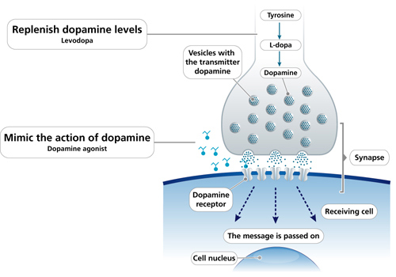
Dopamine agonists

Slide 27
Dopamine agonists
Effectiveness : less than L-dopa
Adverse effects : Less dyskinesia
: More central AE
Uses
As adjuvant therapy with levodopa
As monotherapy (Ropinirole, carbergoline)

Slide 28
Selegiline
A selective MAO inhibitor (Type B)
Inhibits breakdown of dopamine in corpus striatum

Slide 29
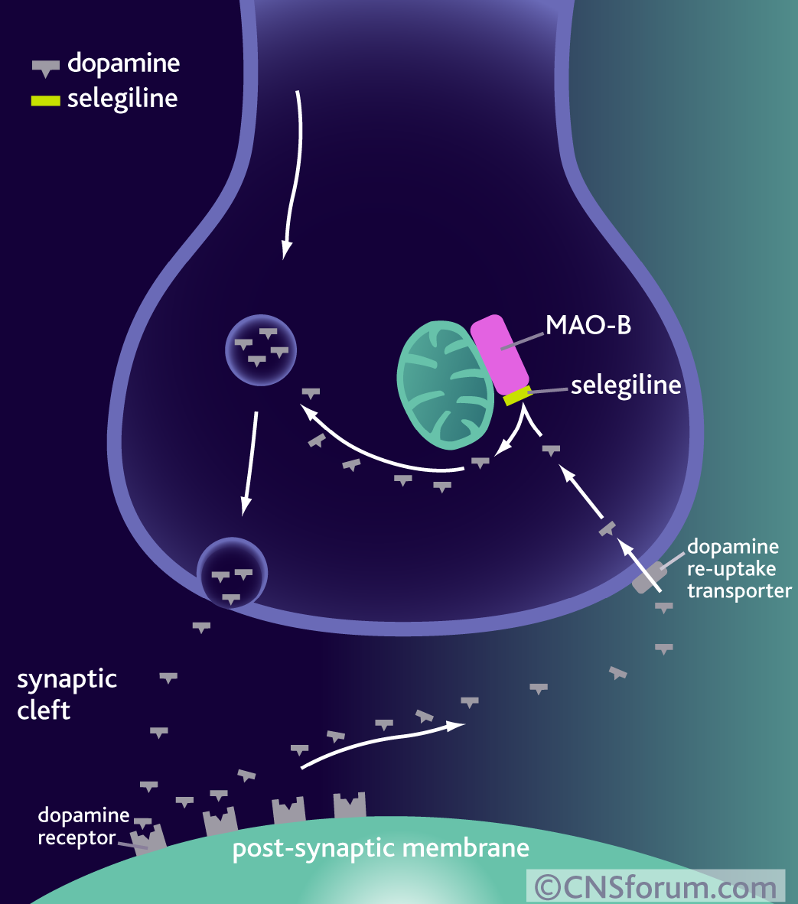
Selegiline

Slide 30
Selegiline
A selective MAO inhibitor (Type B)
Inhibits breakdown of dopamine in corpus striatum
Effectiveness : less than L-dopa
Adjuvant to L-dopa in end of dose deterioration
Adverse effects : More central AE

Slide 31
Amantadine
An antiviral
Increase synthesis and release of dopamine
Effectiveness - less than L-dopa
- more than anti cholinergic
Adverse effects
- CNS disturbances
- Postural hypotension
- Ankle oedema

Slide 32
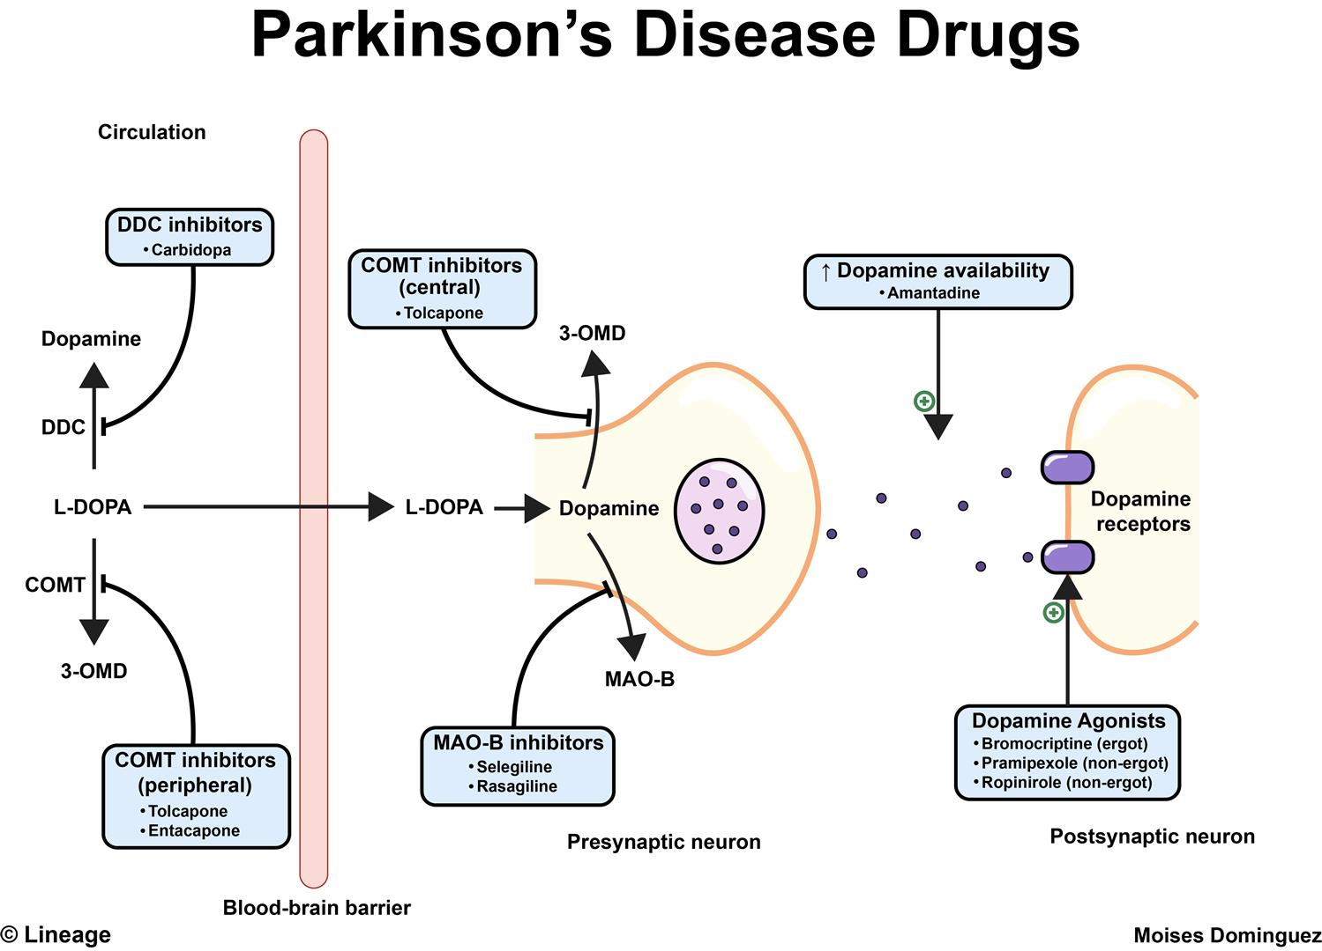

Slide 33
Anti cholinergic drugs
Idiopathic Parkinson disease
To control tremors
Minimal effect on other symptoms
Rx of choice for drug induced parkinsonism
(dopamine receptors are already blocked)

Slide 34
Anti cholinergic drugs
Adverse effects
Central AE’s (confusion, hallucinations)
Dry mouth, constipation, urine retention
Blurred vision
Can precipitate closed angle glaucoma

Slide 35
Dyskinesias

Slide 36
Dystonias
Acute drug induced dystonia
Caused by dopamine antagonist
Metachlopramide, Domperidone
Antipsychotics eg : haloperidol, chlophromazine
Treatment
Benzhexol / Benzotropine

Slide 37
Benign essential tremor
Non selective beta blockers eg : propranolol
Primidone (an anti epileptic)
clonazepam

Slide 38
Spasmodic torticollis, hemifacial spasms, blepharospasms
Botulinium toxin
Chorea
Phenothiazines, Tetrabenzine

Slide 39
Hemibalism :
Tetrabenzine
Tics
Haloperidol
Spasticty
Baclofen(GABA agonist), Diazepam

Slide 40
THANK YOU

